Slide 1
CS422 Database systems
Today: Execution models for distributed computing – 2nd generation
Data-Intensive Applications and Systems (DIAS) Laboratory École Polytechnique Fédérale de Lausanne

Slide 2
Last week
Hadoop/MapReduce and architectural choices
The MapReduce opponents
This week
The Spark ecosystem – architectural choices
The Spark SQL interface
Problems with skew
Both Spark & MapReduce

Slide 3
Problems with MapReduce
Performance: Extensive I/O
Everything is a file stored in hard disk
Programming model: Limited expressiveness
E.g., iterations, cyclic processes
Procedural code, difficult to optimize
MapReduce is a major step backwards
DeWitt and Stonebreaker, 2008

Slide 4
The data flow model
Construction goals
Improve expressiveness and extensibility of model
Make coding easier: strive for high-level code
Enable additional optimizations
Increase performance by better utilizing the hardware
Representative examples
Microsoft
Dryad
Google
Pregel
Apache Pig

Slide 5
The Spark Unified Stack
The Spark Unified Stack

Slide 6
Architectural choices of Spark
Storage layer
Resilient distributed datasets
Programming model & exec. engine
Resource management
Fault tolerance

Slide 7
Storage layer
Abstraction: Developers are NOT reading from/writing to files explicitly. A distributed storage layer handles all data accesses and utilizes distributed RAM
MapReduce: Everything is written to the DFS (HDD) to handle fault-tolerance and distribution
Spark key concept: Resilient Distributed Datasets (RDDs)

Slide 8
Resilient Distributed Datasets
Distributed, fault-tolerant collections of elements that can be operated in parallel
Created by
Loading of data from stable storage, e.g., from HDFS
Manipulation of existing RDDs
Core properties
Immutable
Distributed
Lazily evaluated
Cacheable → by default, stored in memory!
Replicated on request

Slide 9
Resilient Distributed Datasets (2)
RDDs contain
Details about the data
Data location, or data itself
Lineage (history) information to enable recreating a lost split of an RDD
Dependencies from other RDDs
Functions/transformations
E.g., RDD1=sc.textFile("hdfs://..."); RDD2=RDD1.filter(…); RDD3=RDD2.map(…); …

Slide 10
RDDs Vs Hadoop HDFS
 | RDDs |  | Hadoop HDFS
Performance | Exploits RAM |  | Everything written on disk
Fault tolerance | Lineage (& replication) |  | Replication

Slide 11
Architectural choices of Spark
Storage layer
Programming model & exec. engine
Resource management
Fault tolerance

Slide 12
Programming models – an overview
MapReduce simple but weak for some reqs.
Cannot define complex processes
Batch mode, acyclic, not iterative
Everything is file-based, no distributed memory
Procedural → difficult to optimize
More powerful models
Spark, Dryad: processing expressed as a DAG
Vertices: processing tasks, edges: src:target connection
Dremel: Declarative (SQL-like)
Data models
Hierarchical, tabular: Dremel
Directed graph with cycles: Pregel
Spark DAG example

Slide 13
Programming models – examples
Describing the processing tasks
Declarative languages, e.g., Dremel
Functional programming, e.g., Spark
Domain-specific languages, e.g., Pregel
SELECT DocId AS Id, COUNT(Name.Language.Code)
WITHIN Name AS Cnt FROM t
WHERE REGEXP(Name.Url, '^http');
val wordCounts = textFile.flatMap(line => line.split(" ")).
map(word => (word, 1)).
reduceByKey((a, b) => a + b)
wordCounts.collect()
class PageRankVertex
: public Vertex<double, void, double> {
public: virtual void Compute(MessageIterator* msgs) {
const int64 n = GetOutEdgeIterator().size();
SendMessageToAllNeighbors(GetValue() / n);
}
};

Slide 14
Spark: Dataflow and RDDs
Spark development circles around RDDs
RDDs enable
Actions: count, collect, …
Transformations: map, filter, joins, …
Example
lines = spark.textFile("hdfs://...")
errors = lines.filter(_.startsWith("ERROR"))
hdfserrors = errors.filter(_.contains("HDFS"))
.map(_.split(’\t’)(3))
hdfserrors.collect()
Distributed

Slide 15
Spark: Dataflow and RDDs (2)
val textFile = sc.textFile("hdfs://...")
val counts = textFile.flatMap(line=>line.split(" "))
.map(word=>(word,1))
.reduceByKey(_+_)
Actions & Transformations on RDDs fully parallelizable
Synchronization required only on shuffling!
Word-count example
flatMap: split line to words
map: emit <word,1> pairs
reduceByKey: sum counts for each word
3 nodes - different colors

Slide 16
Lazy evaluation in Spark
Spark: Functional language → static rule-based optimizations
Fully exploits lazy evaluation of transformations
Example
lines = spark.textFile("hdfs://...")
errors = lines.filter(_.startsWith("ERROR"))
hdfserrors = errors.filter(_.contains("HDFS"))
timestamps = hdfserrors.map(_.split(’\t’)(3))
timestamps.collect()
Which types of optimizations are
enabled by lazy evaluation?
SELECT Country, Count(*) FROM LogEntry GROUP BY Country

Slide 17
Design choices of Big Data systems
Storage layer
Programming model & exec. engine
Resource management
Fault tolerance

Slide 18
Resource Management
How many map/reduce slots to assign per job
Early MapReduce versions – simple, within scheduler
Yarn/Mesos enable multiple frameworks (Spark, MapReduce, …) to co-exist in harmony over the same nodes
Yarn: decisions of varying granularities
Resource manager
ApplicationMaster
Node manager
Containers

Slide 19
Resource Management (2)
Yarn: decisions of varying granularities
Resource manager
ApplicationMaster
Node manager
Containers
Yarn design enables
Co-existence of multiple frameworks in a shared & secure (isolated) manner
Scalability
Application-specific optimizations possible

Slide 20
Architectural choices of Spark
Storage layer
Programming model & exec. engine
Resource management
Fault tolerance

Slide 21
Fault tolerance
Hardware/software failures are the rule
Heterogeneous hardware
Can be low-end, cheap, unstable
Network size can be in the order of thousands
Data skew
Bugs!
Requirements
Data safety
Job recovery
Minimize effort – recompute as less as possible
Mask failures – do not delay the user!

Slide 22
Data safety
(Up to ) three levels of data safety
Lineage information
Compact and sufficient to recreate missing RDDs
Requires re-computation
HDFS-inherited safety
Replication
Full copies of RDDs on request
Not necessary for safety
Improves recovery performance

Slide 23
Job recovery in Spark
RDDs are resilient and distributed
What happens if green node fails during step 3?
If there is no replica of RDD3?
Need lineage information – history to be able to recreate RDD splits from the source
RDD 1
1. filter
RDD 2
2. map
RDD 3
X
3. map
RDD 4

Slide 24
Job recovery in Spark (2)
RDDs contain
data: stored in main memory whenever possible
lineage information: for failure resistance
RDD2=RDD1.filter(…), RDD3=RDD2.map(…), …
Performance impact of failures

Slide 25
Spark SQL

Slide 26
The Spark Unified Stack
The Spark Unified Stack

Slide 27
Limitations of vanilla Spark
RDDs are schema-less
Inefficient: think of accessing raw text files
Expensive: high space overhead
Important optimizations not supported!
Access a single column → parsing to find position
Queries cannot refer to attributes
Think of implementing SQL capabilities

Slide 28
The RDD coding nightmare!
Using RDDs
data = sc.textFile(...).split("\t")
data.map(lambda x: (x[0], [int(x[1]), 1])) \
.reduceByKey(lambda x, y: [x[0] + y[0], x[1] + y[1]]) \
.map(lambda x: [x[0], x[1][0] / x[1][1]]) \
.collect()
Using SQL
SELECT name, avg(age)
FROM people
GROUP BY name
Using DataFrames
sqlCtx.table("people") \
.groupBy("name") \
.agg("name", avg("age")) \
.collect()
Using Pig
P = load '/people' as (name, age);
G = group P by name;
R = foreach G generate AVG(G.age);

Slide 29

Plan of attack
Add schema to RDDs
Space-efficient data representation
Computationally-efficient access to individual attributes
Offer an extensible SQL-like language
Easier to express queries
SQL-like optimizations on data accesses
And its name is…
Spark SQL
SQL

Slide 30
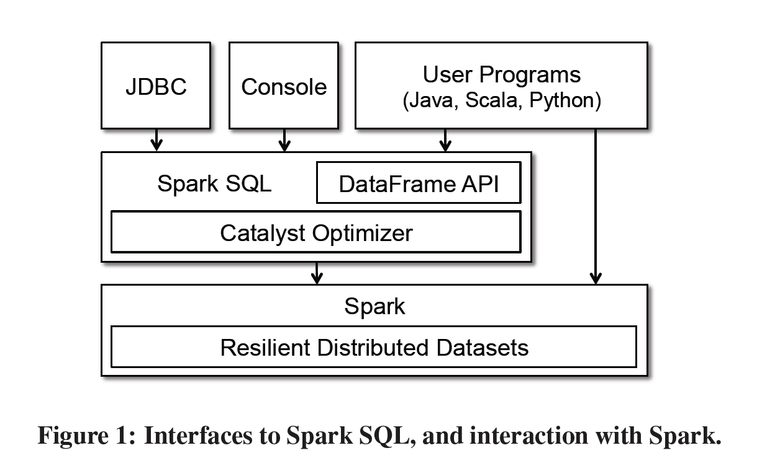
Spark SQL programming interface

Slide 31
Data model
Nested data model
Supports all primitive SQL types (boolean, integer, string, …)
Supports complex types (structs, arrays, maps, unions)
User-defined types
Complex data types are first-class citizens, amenable to optimizations

Slide 32
Key notion: Data frames
Unstructured
RDD
Data frame
John, 20, Developer
Marissa, 63, Manager
Bill,61, Owner
Jack,21, Developer
…
name | age | role
John | 20 | Developer
Maria | 63 | Manager
Bill | 61 | Owner
Jack | 21 | Developer
… | … | …
createDataFrame(…)
Columnar
representation

Slide 33
Unstructured
RDD
Data frame
John, 20, Developer
Marissa, 63, Manager
Bill,61, Owner
Jack,21, Developer
…
name | age | role
John | 20 | Developer
Maria | 63 | Manager
Bill | 61 | Owner
Jack | 21 | Developer
… | … | …
createDataFrame(…)
Data frames created from
RDDs
Manipulation of other data frames
Other data sources
relational dbs, csv files, …
can utilize capabilities of the data source, e.g., filtering
Columnar
representation

Slide 34
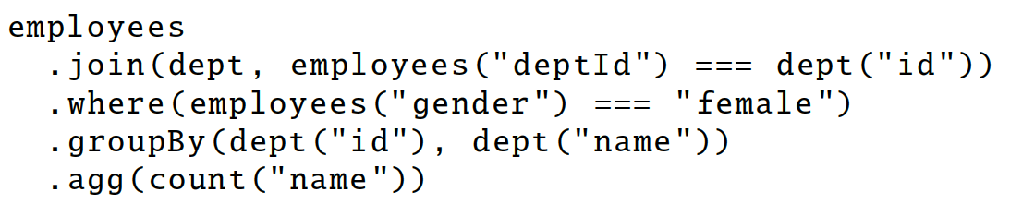
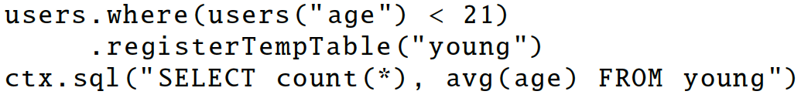
DataFrame operators
Relational operations via a Domain Specific Language
Input: expression
Output: an abstract syntax tree (AST)
Chaining of operators
Alternatively, use traditional SQL

Slide 35
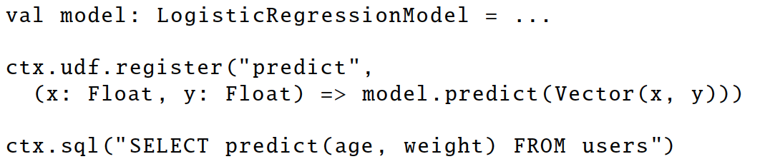
User Defined Functions (UDFs)
Easy extension of supported operations
Allows inline registration of UDFs
Can be defined on simple data types or on entire tables
UDFs also available to other interfaces after registration

Slide 36
Optimization principles
Declarative language to express user’s information needs
Write less code → let the optimizer do the hard work
Lazy evaluation → holistic optimization
Get ALL operations and optimize them as a whole
Code generation to avoid interpretation overhead

Slide 37
Catalyst optimizer
Input
Abstract Syntax Tree
Performs
Analysis to resolve references
Logical optimization
Physical planning
Output
Optimized AST → Code generation
SQL
DataFrame
AST
Catalyst
Code
Execution
RDD

Slide 38
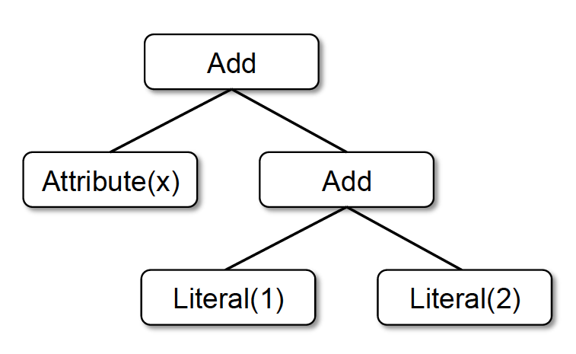
Abstract syntax trees
ASTs represent user query
Nodes of different types In example:
Attribute(name:String)
Literal(value: Int)
Add( left: TreeNode, right:TreeNode)
Similar to a naïve query plan
x + (1 + 2)

Slide 39
Optimization process
Steps
1. Analysis to resolve references
Find unresolved references from the catalog
Verify & determine types
Map named attributes to the input
E.g., SELECT name from tbl where age>10 (using SQL for convenience, in practice AST)
Result: Resolved logical plan, known types, known data location
AST
Analysis
Catalog
Logical opt.
Physical opt.
Code gen.

Slide 40
Optimization process
Steps
2. Logical optimization
Standard rule-based optimization, e.g.:
Push-down predicates
Projection pruning
Simplify logical expressions
…
Result: Optimized logical plan
AST
Analysis
Catalog
Logical opt.
Physical opt.
Code gen.

Slide 41
Optimization process
Steps
3. Physical optimization
Generate candidate physical plans
Define the actual implementation of each operator, e.g., joins
Combine operators, e.g., filters and projections into a single map operation
Push operations from the logical plan into data sources, e.g., to utilize indexes
Result: Optimized physical plan
AST
Analysis
Catalog
Logical opt.
Physical opt.
Code gen.

Slide 42
def add_demographics(events):
u = sqlCtx.table("users") # Load partitioned Hive table
events \
.join(u, events.user_id == u.user_id) \ # Join on user_id
.withColumn("city", zipToCity(df.zip)) # Run udf to add city column
events = add_demographics(sqlCtx.load("/data/events", "parquet"))
training_data = events.where(events.city == "Melbourne").select(events.timestamp).collect()
Logical Plan
Physical Plan
Physical Plan
with Predicate Pushdown and Column Pruning
filter
join
join
join
scan
(events)
filter
optimized
scan
(events)
optimized scan
(users)
events file
users table
scan
(users)

Slide 43
Optimization process
Steps
4. Code generation
AST → java bytecode
Avoid interpretation overhead per row
Branching
Virtual function calls
Compare walking through the whole tree per tuple with: row.get(x)+(1+2)
Bytecode further optimizable from JVM!
AST
Analysis
Catalog
Logical opt.
Physical opt.
x + (1 + 2)
Code gen.
Notes:
This would be PER LINE
add(leftChild,rightChild) {
left=eval(leftChild)
right=eval(rightChild)
return left+right
}
eval(v){
if (v is literal) return value(v)
if (v is attribute) return value(attribute)
if (v is add) return add(v.leftChild, v.rightChild)
}
Instead, replace everything to x+(1+2) → x+3

Slide 44
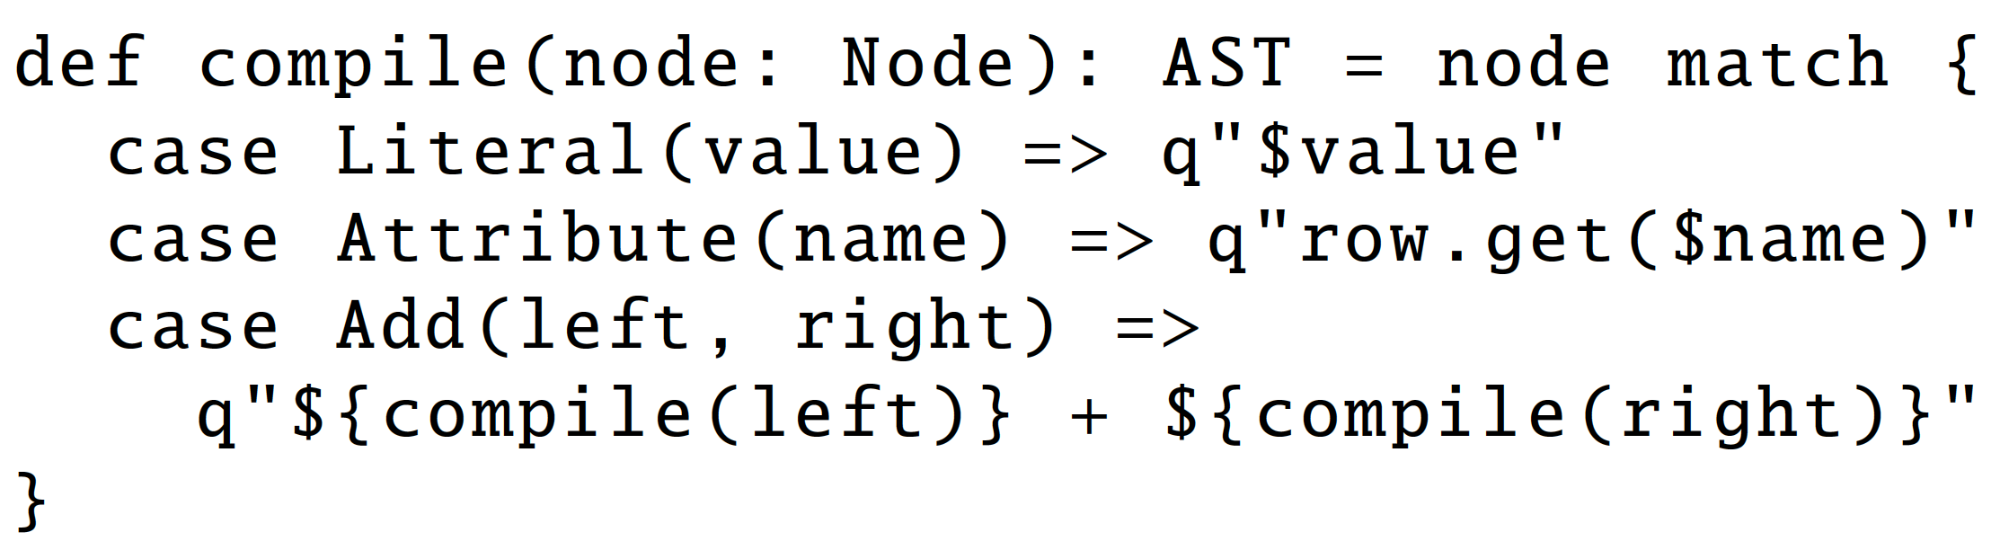
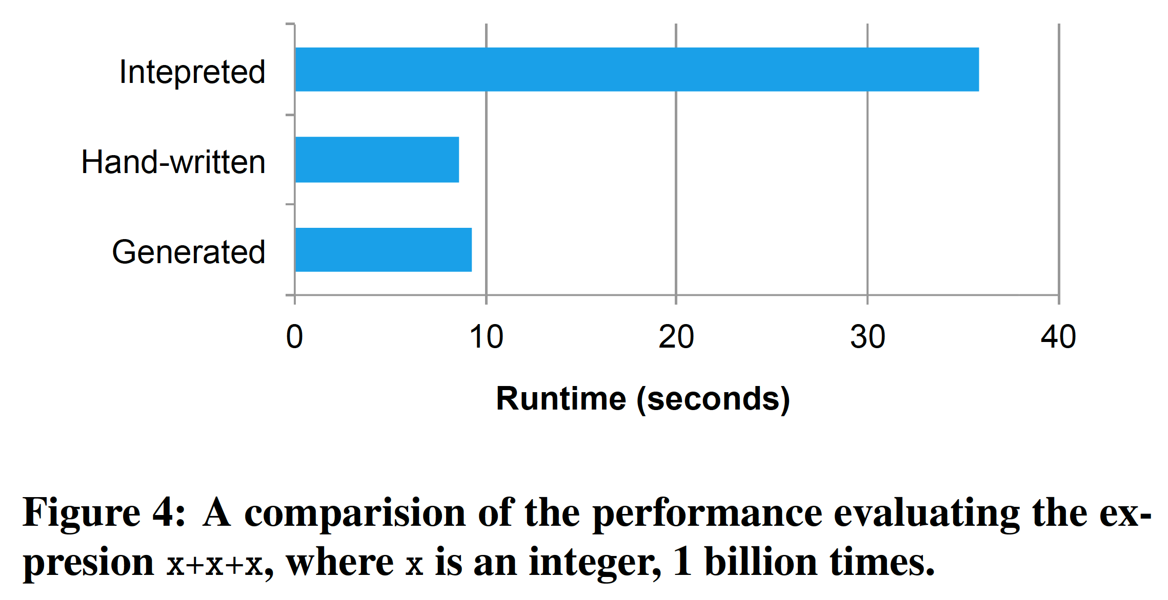
Code Generation
Spark SQL relies on Scala’s quasiquotes to simplify code generation → ~ 1000 lines of code!
Notes:
catalyst does a pretty good job on code generation. Generated code is very close to hand-written code in performance.

Slide 45
Catalyst Rules
Catalyst intelligence expressed with rules
Pattern matching functions that transform subtrees into specific structures.
Multiple patterns in the same transform call.
May take multiple calls to reach a fixed point.

Slide 46
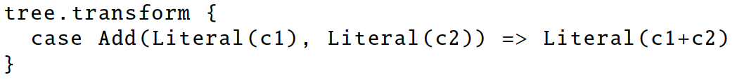
Transformations on ASTs
Rule-based transformations
Add
Attribute(x)
Literal(3)
x + (1 + 2)
x + 3

Slide 47
Transformations on ASTs (2)
Find filters on top of projections.
Check that the filter can be evaluated without the result of the project.
If so, switch the operators.

Slide 48
Holistic optimization
Lazy evaluation → consider all queries together
Optimize the batch as a whole
Example
usersWithAddress = users.join(users.id===addresses.userid)
usersInLausanne = usersWithAddress.filter(city=“Lausanne”)
babiesInLausanne = usersInLausanne.filter(age<2).collect()

Slide 49
filter
filter
scan
(users)
scan
(addresses)
join
scan
(users)
scan
(addresses)
join
filter
filter
Line 3
Line 2
Line 1
Example
usersWithAddress = users.join(users.id===addresses.userid)
usersInLausanne = usersWithAddress.filter(city=“Lausanne”)
babiesInLausanne = usersInLausanne.filter(age<2).collect()

Slide 50
Optimizing UDFs
UDFs are black boxes
For Catalyst, black boxes are bad boxes!

Slide 51
Optimizing UDFs
Making UDAFs optimizable
User Defined Aggregate Functions
Define Initialize, Update, Merge, Evaluate
Can distribute computation & reduce network
Notes:
http://spark.apache.org/docs/2.1.0/api/java/org/apache/spark/sql/expressions/UserDefinedAggregateFunction.html

Slide 52
Advantages of model over SQL
Easier, more flexible language
Easy to add control structures (e.g., if, for, …)
More intuitive to perform complex operations
Holistic optimization across functions composed in different languages

Slide 53


Slide 54
Handling skew
Goal: minimize job completion time
Available hardware
Algorithm’s degree of parallelism (DoP)
Need to be able to parallelize the execution
MapReduce & Dataflow models promote high DoP (with assumptions)
Robustness to skewed data
Skewness on reduction key affects performance
Highly skewed data → many keys end up at the same node
Overloaded nodes become the bottleneck

Slide 55
Problems with skew
Typical partitioning: hash-based
Uniform distribution of reduction keys → uniform load at the reducers
Real data typically follows skewed distribution
Word “the” occurs far more frequently compared to word “arachnophobia” in a book

Slide 56
Problems with skew
Typical partitioning: hash-based
Uniform distribution of reduction keys → uniform load at the reducers
Real data typically follows skewed distribution
Word “the” occurs far more frequently compared to word “arachnophobia” in a book
Number of customers of each company, size of cities, in-links of websites, Facebook likes, …
Implications for efficient processing
Skew problem underlying both Spark and MapReduce

Slide 57
Warm-up: word-count in MR
Shuffle phase
Final counts
Map
phase
Sort Send Merge
Reduce
phase
DFS
DFS
< arac…,1>
<Imag..,{1}>
<Imagi…,1>
Input data
Reduce
Split
Map
<the,1>
<the, {1,1,..}>
<the, 9423343>
<Imag..,1>
…
…
…
Split
Map
<get,1>
<get,{1,..}>
<get,12>
Reduce
<the,1>
<arac..,{1}>
<arac..,1>
<take,1>
<take,{1}>
<take,27>
…
…
…
for each word in value
emit pair <word,+1>
for each value in list(values)
count+=value
emit pair<word,count>

Slide 58
How about joins?
Join condition: S.A = T.A
Standard implementation
Map(s) = (s.A, s); Map(t) = (t.A, t)
Reduce combines S-tuples and T-tuples with the same key

Slide 59
Problems With Standard Approach
Degree of parallelism limited by the number of distinct A-values
Data skew
If one A-value dominates, the reducer processing that key will become bottleneck
Does not generalize to other joins
Theta-joins: S.A < T.A, |S.A-T.A|<2, …
Alper Okcan et.al.: Processing theta-joins using MapReduce. SIGMOD Conference 2011.

Slide 60
Reducer-Centric Cost Model
Difference between join implementations starts with Map output
Processing time at reducer is approximately monotonic in input and output size

Slide 61
Optimization Goal Revisited
Assume all reducers are similarly capable
Need to minimize:
Max-reducer-input and/or
Max-reducer-output
Join problem classification
Input-size dominated: minimize max-reducer-input
Output-size dominated: minimize max-reducer-output
Input-output balanced: minimize combination of both

Slide 62
Partitioning the load
Join-matrix M: M(i,j) = true, iff (s_{i}, t_{j}) is in join result
Cover each true-valued cell by one reducer
Example: equi-join:
T 5 7 7 7 8 9
S
5
7
7
8
9
9
M(2,1)
M(5,3)

Slide 63
Standard Equi-Join Alg.
Random Assignment
Balanced Algorithm

Slide 64
Theta-Join Model
Join-matrix M: M(i,j) = true, iff (s_{i}, t_{j}) is in join result

Slide 65
A first attempt: Cartesian product
Cartesian product: S.A x T.A
Assume r=3 (3 reducers)
Matrix-to-reducer
mapping
reducers
S T
5→(1),(2) 5→(1),(3)
7→(1),(2) 7→(1),(3)
7→(1),(2) 7→(1),(3)
8→(1),(2) 7→(2),(3)
9→(3) 8→(2),(3)
9→(3) 9→(2),(3)
T 5 7 7 7 8 9
S
5
7
7
8
9
9
1
2
Can apply any join algorithm at the reducers
3

Slide 66
Discussion on first attempt
Correct & complete results (why?)
Each result is produced exactly once
Uniform load
Need to map each S tuple to a row & each T tuple to a column → requires pre-processing
☺
T 5 7 7 7 8 9
S
5
7
7
8
9
9
☹
1
2
3

Slide 67
1-Bucket-Theta algorithm
Observation 1
Correctness/completeness of results unaffected if a row/column contains <>1 tuples
5,7 --- 7 7 8 9
T 5 7 7 7 8 9
S
5
7
7
8
9
9
5
7
7
7
---
8,9
1
2
3

Slide 68
1-Bucket-Theta algorithm
Observation 2
Order of the columns is not important
5 8 7 9 7 7
T 5 7 7 7 8 9
S
5
7
7
8
9
9
7
5
8
9
7
9
1
2
3

Slide 69
1-Bucket-Theta algorithm
Observations
Correctness/completeness of results unaffected if a row/column contains <>1 tuples
Order is not important
Trick
Randomly map each tuple to one row/column
No preprocessing
1 2 3 4 5 6
T 5 7 7 7 8 9
S
5
7
7
8
9
9
1
2
3
4
5
6
1
2
3

Slide 70
1-Bucket-Theta: Map
Input:
tuple
matrix-to-reducer mapping lookup table

Slide 71
1-Bucket-Theta: Reduce
Input:
(ID, [(x₁, origin₁), … , (x_{k}, origin_{k})])

Slide 72
1-Bucket-Theta Example

Slide 73
Why Randomization?
Avoids pre-processing step to assign row/column IDs to records
Effectively removes output skew
Input sizes very close to target
Chernoff bound: due to large number of records per reducer, probability of receiving 10% or more over target is virtually zero

Slide 74
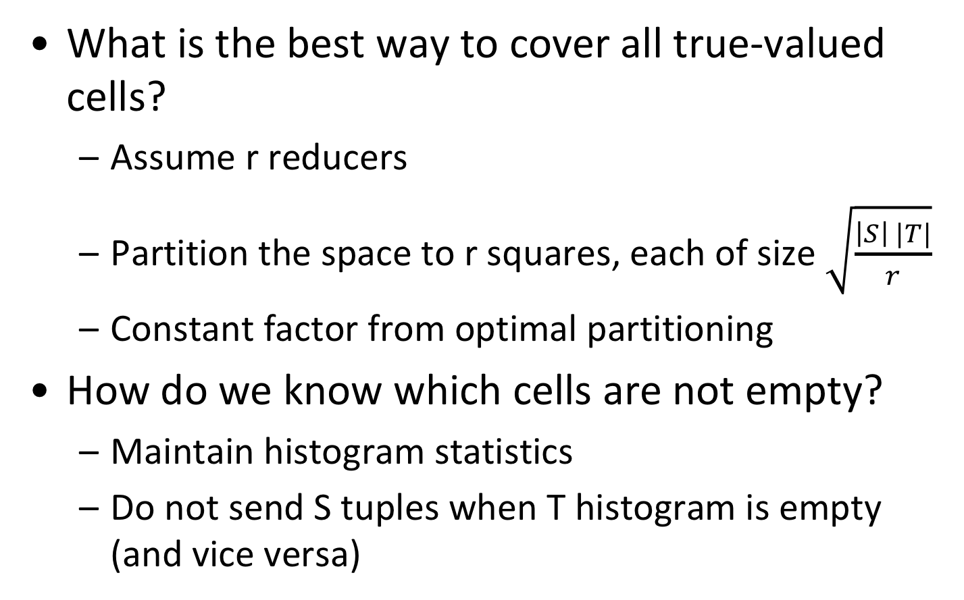
Remaining Challenges
What is the best way to cover all true-valued cells?
Assume r reducers
Partition the space to r squares, each of size $\sqrt{\frac{\left|S\right| |T|}{r}}$
Constant factor from optimal partitioning
How do we know which cells are not empty?
Maintain histogram statistics
Do not send S tuples when T histogram is empty (and vice versa)

Slide 75
Summary
Spark richer model than MapReduce
Addresses some of the major problems of MapReduce
Adding more machines is not always a solution
Skew can drastically reduce degree of parallelism
Need to have suitable algorithms

Slide 76
Reading material
M. Zaharia, et.al.: “Resilient Distributed Datasets: A Fault-Tolerant Abstraction for In-Memory Cluster Computing”, NSDI 2012.
Armbrust et al.: Spark SQL: Relational Data Processing in Spark. SIGMOD Conference 2015: 1383-1394
Shivnath Babu, Herodotos Herodotou: Massively Parallel Databases and MapReduce Systems. Foundations and Trends in Databases 5(1): 1-104 (2013). Section 5. Available online at http://www.nowpublishers.com/article/Details/DBS-036
Alper Okcan et.al.: Processing theta-joins using MapReduce. SIGMOD Conference 2011. http://www.ccs.neu.edu/home/mirek/papers/2011-SIGMOD-ParallelJoins.pdf

Slide 77
Reading material
Technical readings
Spark DATABRICKS tutorial: https://www.youtube.com/watch?v=VWeWViFCzzg
Spark references:
Learning Spark: Lightning-Fast Big Data Analysis. Holden Karau, Andy Konwinski, Patrick Wendell, Matei Zaharia.
Official documentation at http://spark.apache.org, http://spark.apache.org/docs/latest/quick-start.html, http://spark.apache.org/docs/latest/programming-guide.html

